Slide 1

Don Bosco Institute of Technology
Department of Computer Engineering (Session 2023-24 EVEN)
S.E. Computer
Mini Project 1B Progress Review II “HEALTH PREDICTION WEB APP”
Group No. - 12
MENTOR: MS POOJA B
Team Members:
Amisha Verma [66]
Ashita Salis [55]
Merina George Thoppil [63]
16 April 2024

Slide 2
Introduction
Our Health Prediction Web App is a revolutionary solution aimed at transforming healthcare accessibility. With a user-friendly interface and robust functionalities, it's designed to streamline the healthcare experience for both users and administrators.

Slide 3


Problem Statement
Problem 1
Problem 2
Traditional healthcare systems often involve complex processes for appointment booking, symptom management, and remedy tracking.
People find it hard to keep track of their health information because it's scattered across different systems.

Slide 4


Solution by our Smart Health Care App
Addresses the challenge of healthcare data fragmentation by providing a unified platform for users to consolidate their health records, symptoms
Solves this by bringing all your health records, symptoms into one easy-to-use platform integrating with various healthcare providers and putting your health data at your fingertips.
Solution 1
Solution 2

Slide 5


Similar Apps
Ada Health
Buoy Health
K Health
HealthTap
Your.MD

Slide 6

How our Application eases lifestyle
This app simplifies symptom tracking providing users with a hassle-free experience. Whether it's managing health from the user perspective or efficiently handling administrative tasks, our Health prediction Web App enhances accessibility and convenience, making healthcare management a breeze.

Slide 7
Traction
User-Friendly Symptom Management: The "ADD symptoms" feature simplifies symptom tracking. Users can effortlessly input and update their symptoms, streamlining the process and ensuring that their health status is always up-to-date.
Faqs :Users can access answers to the questions they have regarding the web application.

Slide 8
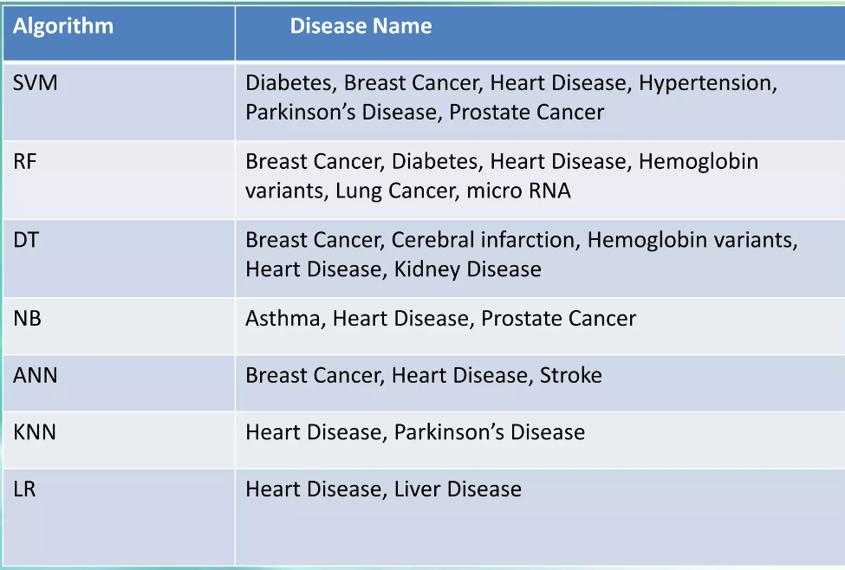
Algorithms
Linear Regression,
Support Vector Machine, Decision Tree,
Random Forest,
Naïve Bayes,
K-nearest neighbour,
Artificial Neural Network.

Slide 9
Naive Bayes Algorithm
Naïve Bayes: Naïve Bayes (NB) is a classification technique based on the Bayes' theorem. This theorem can describe the probability of an event based on the prior knowledge of conditions related to that event. This classifier assumes that a particular feature in a class is not directly related to any other feature although features for that class could have interdependence among themselves.

Slide 10





Site Map
User name
enter Symptoms
Login
Password
Register
Start
GOAL SETTING
Goals in Life
Consult Doctor if needed
Provide prediction

Slide 11
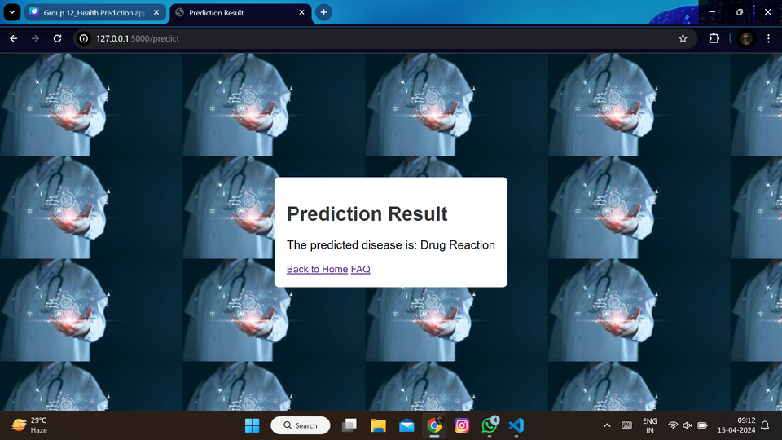
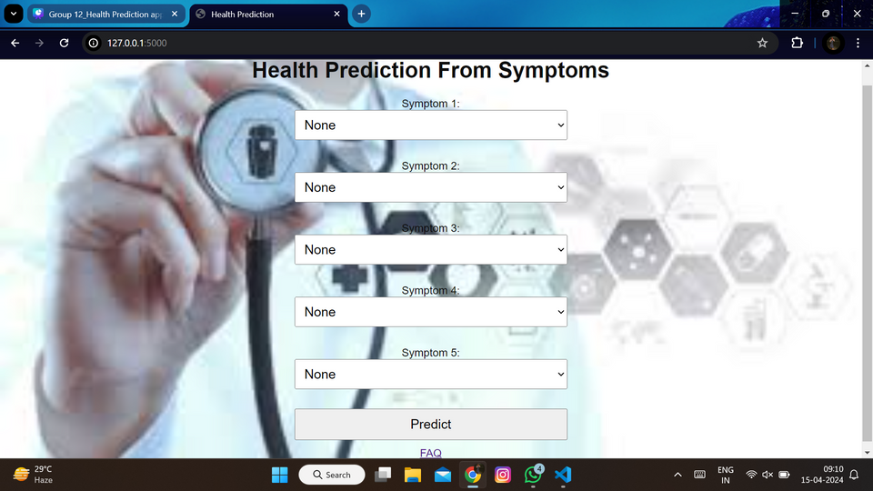
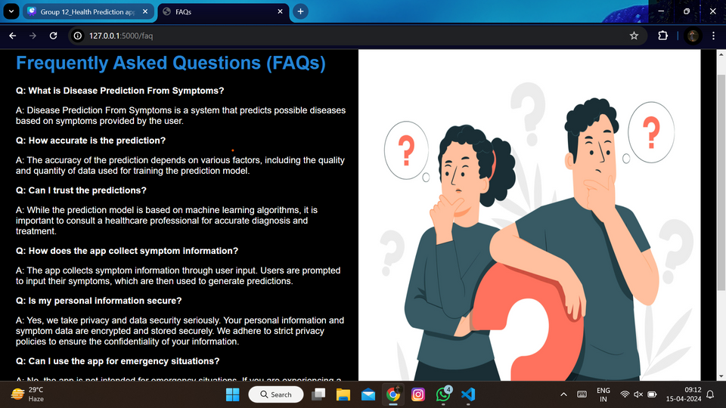

Slide 12
References
https://www.irjet.net/archives/V10/i6/IRJET-V10I697.pdf https://www.researchgate.net/publication/343345506_Smart_Health_Prediction_System_with_Data_Mining https://ijcrt.org/papers/IJCRT2204206.pdf https://www.irjmets.com/uploadedfiles/paper//issue_7_july_2023/43392/final/fin_irjmets1690015112.pdf https://www.mdpi.com/2078-2489/14/3/181 https://www.ijset.in/wp-content/uploads/IJSET_V9_issue1_159.pdf https://www.irjet.net/archives/V4/i4/IRJET-V4I4669.pdf
Conclusion
Our Health Prediction web App stands out from existing healthcare apps through its focus on simplicity, integration, and personalization.
By prioritizing user-friendly features such as effortless symptom tracking, efficient remedy management.
In summary, our Health prediction web App sets itself apart by offering a comprehensive yet intuitive solution that streamlines healthcare management, bridges the gap between fragmented health information, and promotes proactive and personalized health care.

Slide 13
Thank
You!
PRESENTED BY GROUP 12

